Slide 1
3M IT ALM Tools Discussion September, 2014

Slide 2
IT’s Vital Few
Keep the Train Running while meeting existing SLAs
SAP: Stabilize Canada, continue business readiness, and build-out and deploy 14A through 14D, Supply Chain COEs, U.S. Interim State, and the MES Solution
Support new or existing Acquisition Integrations and Divestitures
Build-out and deploy approved eTransformation capability
Build-out and deploy Polaris reporting and metrics
Expand our Service Business offering
Complete execution of Human Capital Plan
Deliver Operational Excellence through rigorous prioritization, governance, cost control, contract & vendor management, and re-energize Lean Six Sigma
With Relentless Focus on Quality, Testing, Security, and Compliance

Slide 3
IT Quality Management System Updates
Laws & Regulations
Corporate Policies & Standards
IT Quality Manual
IT Global Standard Operating Procedures (GSOPs)
Local SOPs and Work Instructions
Governance, Records
Established IT Quality Governance Board w/Legal, IT, Finance, and Business Representation
Standardized 15 Regulatory & Compliance Categories covering over 75 individual compliance areas
Created compliance SME matrix for compliance categories – global, regional, local
Update beyond validation– strategic platforms to higher, more consistent standard
Encompass key elements of External Standards, particularly ISO 27001, ITI L
Address evolving IT trends – cloud, mobile, IT services, etc.
Bring GSOP’s current by September 30th, 2014
Revised GSOP Training approach – target 15 minute w / KA
Establish strategic ALM/SDLC/ADMLC standards
Rationalize ALM Tools and SOPs going forward
Align IT Quality Organization
Refine QMR for evolving quality emphasis
Imbedded Quality, Compliance , and traceability in Gate Reviews
Notes:
SPEAKER TEXT
Another way to view the hierarchy of the Quality Management System is the common pyramid diagram. The hierarchy starts with Laws and Regulations and ends with the quality records we create as a part of our work. The new element in the diagram is the Quality Manual.
[click] The IT GSOPs and IT NSI Methodology make up the base of the hierarchy and have been in place for some time.

Slide 4
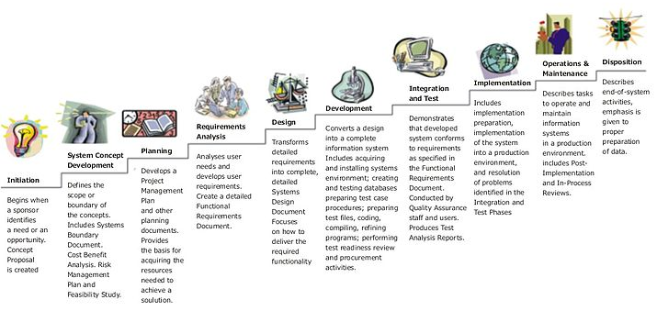
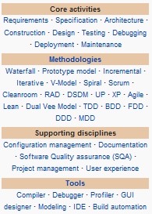
Context:

Slide 5
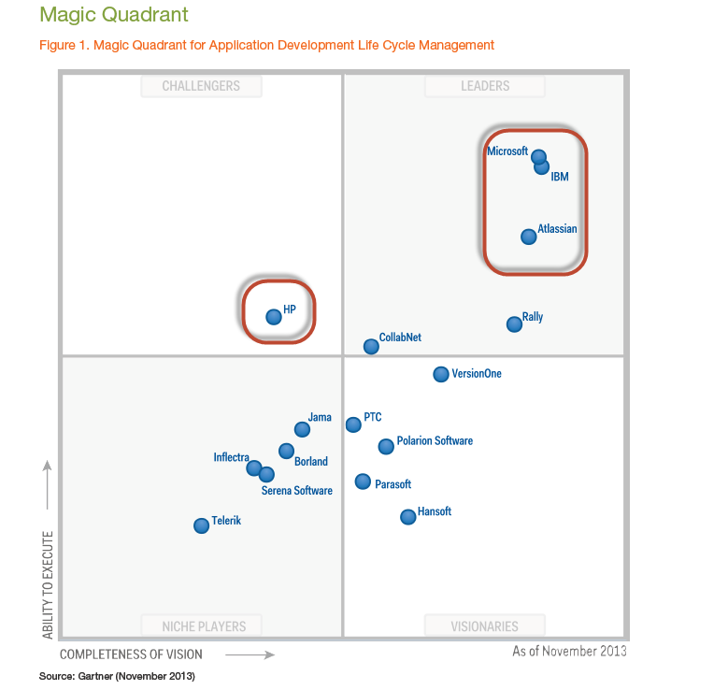
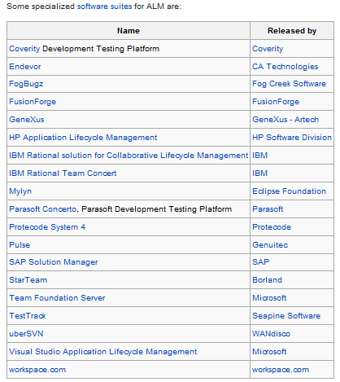
Industry Landscape for ALM / SDLC / ADLCM:
Source: Wikipedia September 2014

Slide 6
3M Current State for ALM Tools:
3
1
2
Fragmented / incomplete tool strategy for core Quality & Test Management – Validation / Quality Risk
Relatively immature tools and processes for Post-Deployment Maintenance & Optimization – Productivity / Capability Concerns
Limited strategic direction for Portfolio / Demand Management – Prioritization / Service Delivery Exposure

Slide 7
The Ask
Participation
Verify as-is
Define requirements / needs to support IT’s customers
Formulate standards
Assess and recommend tools
ACE
eTransformation
R&D
Non-SAP Core
SAP
Infrastructure
Brandon Knutson – software products
Penny Destache – application platform and integration
Quality
Tools
Quality Assurance

